Slide 1
ENERGY RESOURCES

Slide 2
ENERGY RESOURCES
• Energy is the capacity to do work and is required for life processes. An energy resource is something that can produce heat, power life, move objects, or produce electricity

Slide 3
NON RENEWABLE ENERGY RESOURCES
Non-renewable energy is energy which is taken from the sources that are available on the earth in limited quantity and will vanish fifty-sixty years from now.
Non-renewable sources are not environmental friendly and can have serious affect on our health.
They are called non-renewable because they cannot be re-generated within a short span of time.
Non-renewable sources exist in the form of fossil fuels, natural gas, oil and coal.

Slide 4
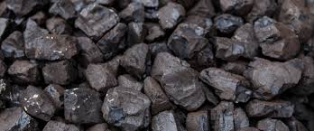
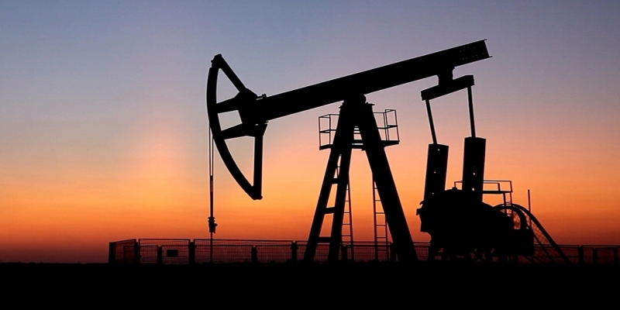
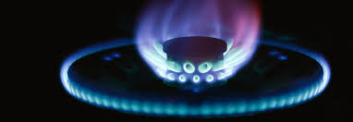
FOSSIL FUEL ENERGY
• Coal, petroleum, and natural gas are called fossil fuel as these are formed by the decomposition of the remains of dead plants and animals buried under the earth for a long time

Slide 5
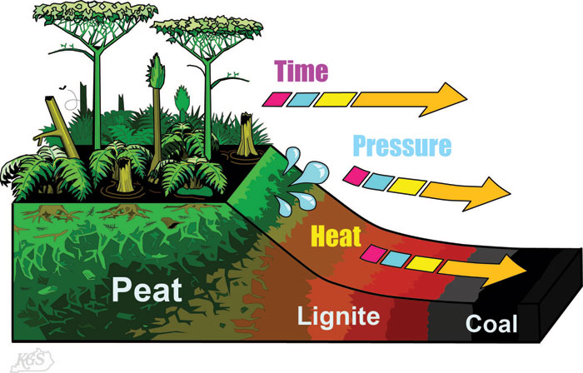
HOW IS COAL FORMED?
Coal is formed by carbon, hydrogen, oxygen, nitrogen and varying amounts of sulphur. The dead plants from the swamps are piled up with sand and mud on top. Without water the carbon increases and forms a hard black substance called coal.
Coal is used as a fossil fuel to produce electricity and heat in something such as a train.

Slide 6
IMPACT OF COAL MINING ON ENVIRONMENT
Impact of mining on Air
Co2 emission
Ozone depletion
Global warming and climate change
Mine fires
Impact on water
Impact on land
Mining waste

Slide 7
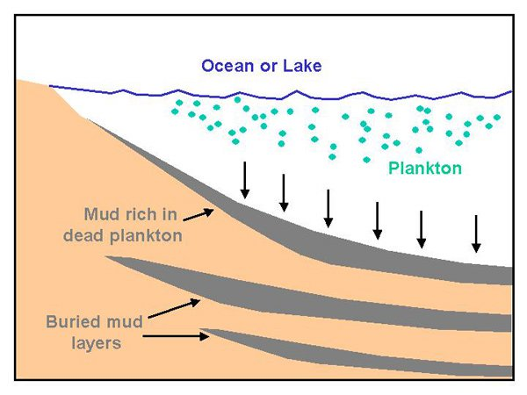
HOW IS OIL FORMED?
Oil was formed from plants called plankton. When the plankton dies, it sinks in the bottom of the sea and is buried under layers of sand and mud. When these layers are mixed it turns into a hard rock, but when bacteria ate the plankton, it turned into ooze, which is now oil.
Oils are used for ,Fuel for lamps , fertilizers, car gas, heating oil for home, planes, ships, factories, food

Slide 8
Advantages
Widely and easily distributed all over world
Easy to store and transport
Cleaner and easier to burn than coal
Reliable electricity
Disadvantages
Growing demand
Non-renewable and fast depleting( used up fast)
Burning produces carbon dioxide which is major cause for global warming leaves harmful products when combusting
Increasing prices

Slide 9
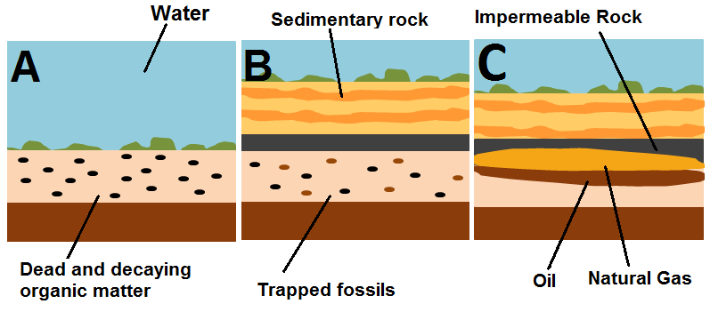
HOW IS NATURAL GAS FORMED?
It is formed from a plant called plankton just like oil. The plankton died, sank to the bottom, and sand and mud covered it up. Over the years, bacteria and heat pressure turned the plankton into natural gas.
Natural gas is used as fossil fuel when people are heating homes, buildings, heating water, fertilizations or cooking

Slide 10
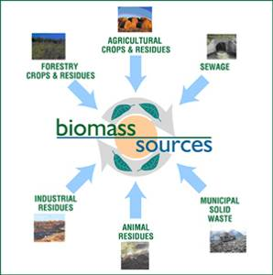

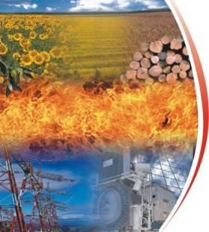
RENEWABLE ENERGY RESOURCES
What is it?
Biomass, is a renewable energy source made of biological material from living, or recently living organisms.
Energy is released by combustion (burning).
Disadvantages
Inefficient (only 30% efficiency).
Releases harmful solid carbon particles into the atmosphere.
Advantages
Produces less pollution than fossil fuels.
Does not cause acid rain.
Can be found locally.
It is renewable.

Slide 11
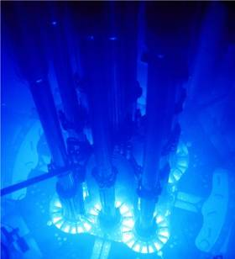

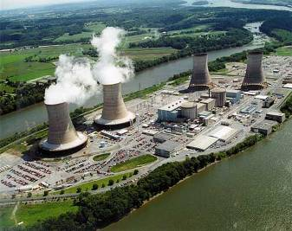
Disadvantages
Harmful radioactive waste is created.
Uranium supplies may only last for another 50 years.
Non-renewable
Radiation may cause cancer
What is it?
Radiation is released from the nuclei of metal atoms.
The radiation can be used to generate electricity.
Advantages
Green House gases are not made.
Only a small amount of fuel is needed to create a lot of energy.

Slide 12
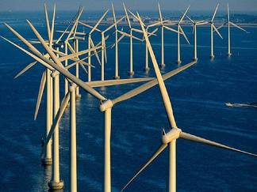

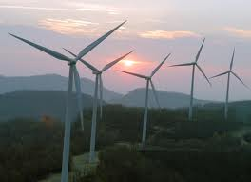
Disadvantages
Lots of wind turbines are needed to produce enough power.
Turbines can only be put in windy areas.
It is not always windy.
Some people don’t like the look of the turbines.
What is it?
Wind turbines are used to generate electricity from the wind.
The wind turns the large blades and the blades turn a generator.
Advantages
Wind is renewable.
Wind is free.
No greenhouse gases are made.
There are few safety risks.

Slide 13
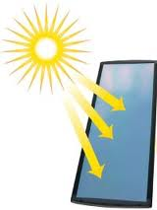

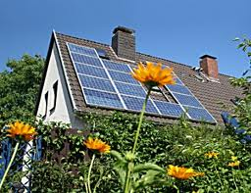
Disadvantages
Solar panels are expensive.
When it is cloudy or at night there is not enough light.
Some people don’t like the look of solar panels.
What is it?
Solar power uses energy from the Sun.
Solar panels transfer the Suns energy to heat water.
Advantages
The energy from the Sun is free.
The sun does not produce greenhouse gases.
The sun will always be there during our lifetime.

Slide 14
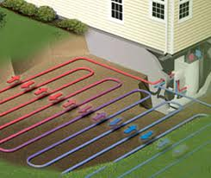

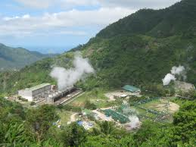
Disadvantages
There are not many places where we can build geothermal power stations.
Harmful gases and minerals may occasionally come up from the ground below. These can be
difficult to control.
What is it?
Rocks under the ground are hot.
Water can be pumped through these hot rocks and warmed up.
Advantages
Geothermal energy does not produce greenhouse gases.
The energy source is free and will not run out.

Slide 15
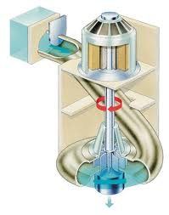

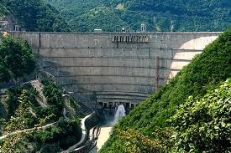
Disadvantages
The dam is expensive to build.
By building a dam, the nearby area has to be flooded and this could affect nearby habitats.
If it does not rain much we may not have enough water to turn the turbines.
What is it?
Flowing water is used to turn a turbine which generates electricity.
Advantages
When the electricity is generated, no greenhouse gases are made.
The water used is free.
It is a renewable energy source.

Slide 16
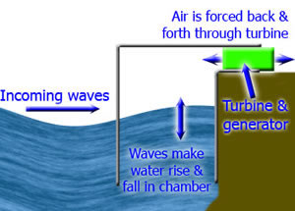
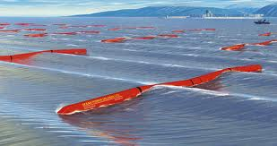
Disadvantages
Small waves generate small amounts of electricity.
Electricity needs to be transported from the sea onto the land.
The equipment is expensive
What is it?
Waves force air in and out of a chamber.
The air causes a turbine to generate electricity.
Wave
Advantages
Waves are free and will not run out.
Wave power does not produce greenhouse gases.
There are very few safety risks.

Slide 17
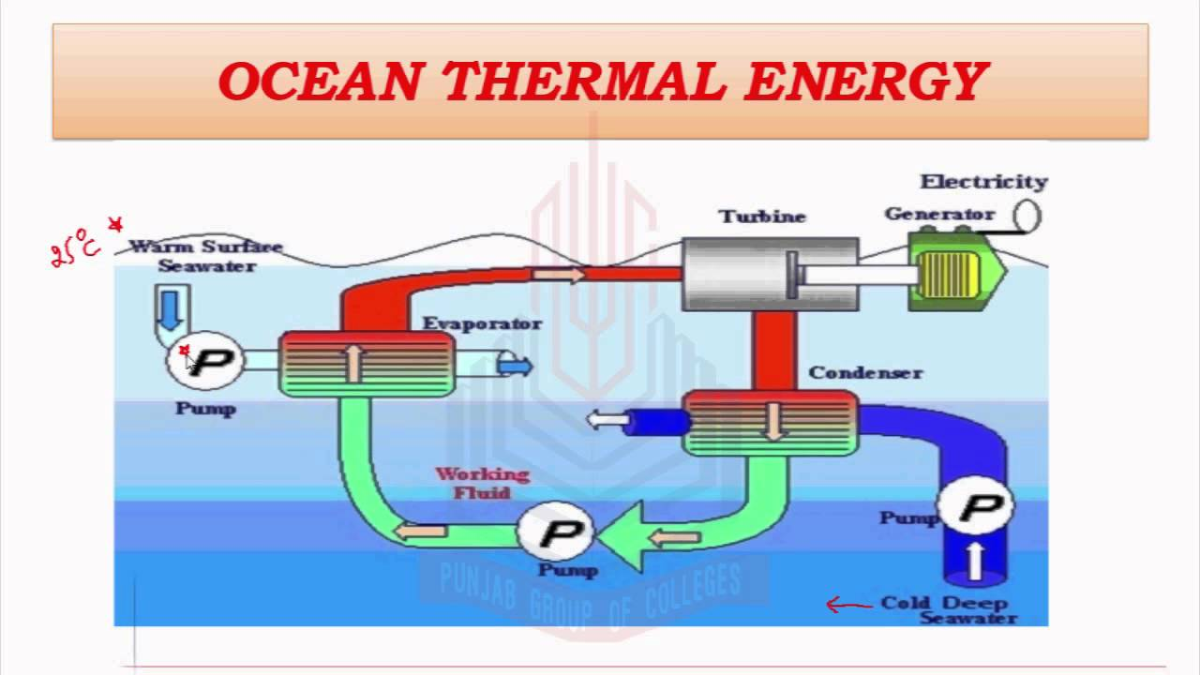
Ocean Thermal Energy Conversion (OTEC)
What is it is
a process that can produce electricity by using the temperature difference between deep cold ocean water and warm tropical surface waters.
OTEC plants pump large quantities of deep cold seawater and surface seawater to run a power cycle and produce electricity.
Advantage:
Run virtually continuously, minimal upkeep is required to keep the flow of electricity running and no harmful byproducts result from the process.
Disadvantage
OTEC power plants cause major adverse impacts on the ocean water quality.
Such plants would require entraining and discharging enormous quantities of seawater.
Marine biota may have an effect on the screens covering the warm and coldwater intakes of an OTEC plan
Small fishes and crustaceans may be entrained through the system, where they will experience rapid changes of temperature, salinity, pressure, turbidity, and dissolved oxygen

Slide 18
THANK YOU

